Slide 1
Radial-Basis Function
(Chap.5.1~5.3)
091601
  by Huafu Chen
SLST, UESTC, China

Slide 2
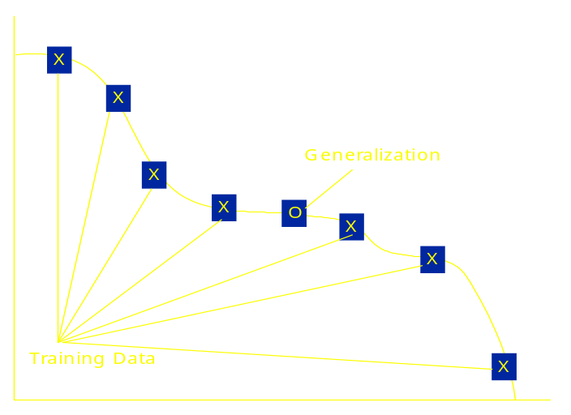
Introduction
What is RBF networks?
  A kind of supervised neural networks
  Design of Neural Networks as curve fitting (approximation) problem/function approximation
  Learning
    Find a surface that best fits to given training data
  Generalization
    use of this multidimensional surface to interpolate test data

Slide 3
Structure of RBF Networks
ϕ
1
(
X
)
X
w
ϕ
1
m
i
x1
2
(
X
)
y
=
?
w
ϕ
(
X
)
w
2
i
=
1
i
i
x2
w
3
?
Output
ϕ
(
X
)
y
x3
3
w
m
...
1
xm0
...
ϕ
(
X
)
More likely to be linearly
m
1
seperated
Increased dimension:
Input layer
Hidden layer
  Hidden units provide a set of basis function
  High dimension: more linearly separable [Cover’s Theorem]
Output layer
  Linear combination of hidden functions
m0<m1
ϕ
i
(
X
)
:
non
linear
function
Notes:
High dimensionality of the hidden space compared to the input space; that diemnsionality is determined by the value assigned to m1( >=m0 ).
隐含层 由一些基函数构成，总体上与MLP类似，但这里从input layer 到 隐含层 是没有权/weight的，这里的input 也不是加权求和，再通过activation function， 而是直接作为输入进入a non-linear function
在MLP 中，activation function 在形式上 是一样的（通常如此），而这里的function 是一组基函数中的不同的个别函数

Slide 4
Cover’s Theorem on Separability(1)
A pattern classification cast in high dimensional space nonlinearly is more likely to be linearly separable than in a low dimension space .

Slide 5





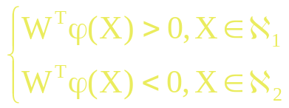

Cover’s Theorem on Separability(2)
feature space
Note: The pattern x is a vector in a m₀ dimensional input space.
The vector maps points x (m0-dimen) to a new space of m1 dimension
hidden function
The space spanned by the hidden functions is refered to as the hidden space or feature space.
A dichotomy is said to be separable( )
if there exists an m1-dimen vector w such that
The hyperplane defination:
Notes:
我们的目标是找一个m1维的矢量函数，由它组合得到的超平面能够分离输入模式
Dichotomy 两分 二叉树

Slide 6
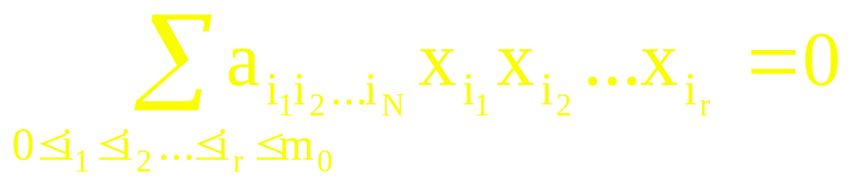

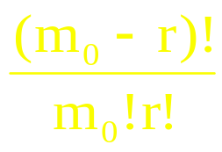
Cover’s Theorem on Separability(2)
Example: A natural class of mappings（自然类映射）
--- a linear combination of r-wise products of the pattern vector coordinates ( components of input vector).
--- r次“模式向量坐标乘积”的线性组合实现的一个自然类映射
-- Polynomial hidden function
    r-th order rational varieties r阶有理簇
(5.4)
Where, x0=1,xi the ith component of input vector x.
Each term in (5.4)
is a monomial （单项式）,
and the total number of the monomial terms is :
Notes:
A natural class of mappings
利用 r次模式向量坐标乘积的线性组合实现的一个自然类映射
在(5.4)中，当 I(j)= I(k) 时 就有了某个分量的高次方；其实质是所有可能的“分量次方” 和 分量的各种乘积 的组合,具体需要那些组合可通过 系数 aiiii来调控
r-th order rational varieties r阶有理簇
monomial（单项式）,

Slide 7
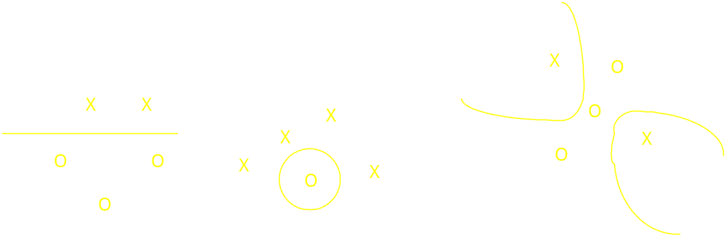
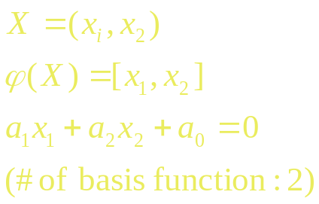
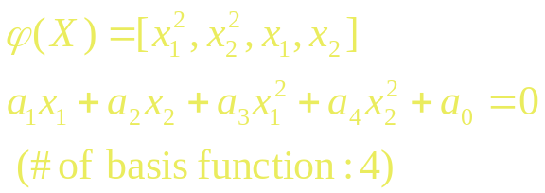
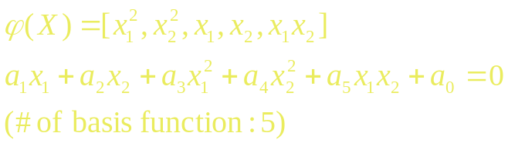
Cover’s Theorem on Separability(2)
Examples
Linearly separable; Spherically; Quadrically separapble dichotomy
Fig.5.1/page 259
1次模式向量坐标的线性组合
1阶 有理式
2次模式向量坐标乘积的线性组合
Notes:
函数表达的是那根曲线

Slide 8

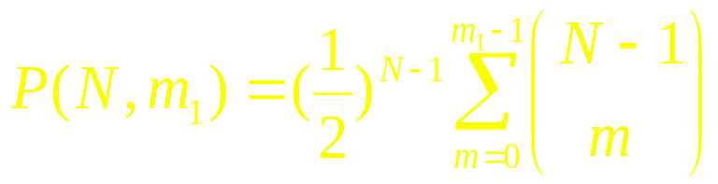
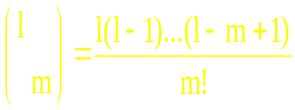
In a sense of probability on separability:
The separability of a set of patterns becomes a random event
that depends on the dichotomy chosen
and the distribution of the patterns in the input space.
  Probability that particular dichotomy picked at random is
(5.5)
Binomial coefficients
    Notations of the above formula (5.5):
    N: # of activation patterns x1,x2,…, they are chosen independently according to the probability measure imposed on the input space.
    Separating surface: m1 degree of freedom
    All the possible dichotomies are equi-probable.
Conclusion: If m1 is increasing, the probability of separability is increasing
Notes:
Dichotomy 二分法、两分；
Binomial coefficients (二项式系数定义）
从概率角度 谈 可分性。

Slide 9

Although the above hidden-unit surfaces are of a polynomial form( Cover’s theory based), they are different from commonly used radial-basis functions, the essential content has general applicability.
Specifically, the higher the dimension m1 , the closer the probability P(N1,m1) will be to unity.
Cover’s theorem encompasses two basic ingredients:
1. Nonlinear formulation of the hidden function defined by
Where x is the input vector, i=1,2,,…, m1.
2. High dimensionality of the hidden space compared to the input space; that diemnsionality is determined by the value assigned to m1( >=m0 ).
( However, in some case, the use of nonlinear mapping ( only the above point 1) may be sufficient to produce linear separability, see the following XOR problem)

Slide 10
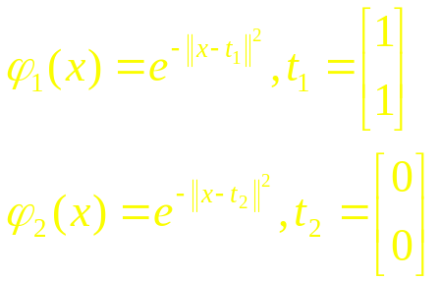
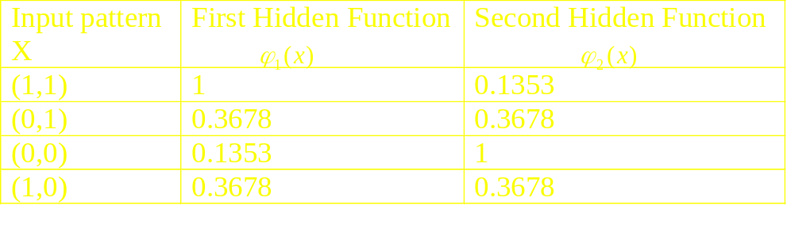

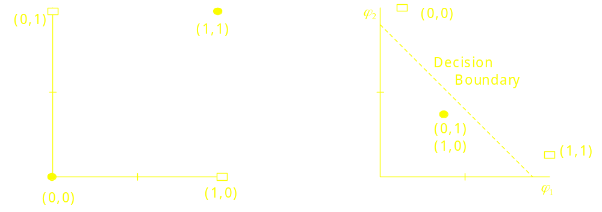
Example: XOR Problem
XOR data are not linearly separable
Nonlinear transformation
Linearly separable in space(figure 5.2)
The four patterns
Decision making diagram
Notes:
After transferred, in the transformed space, a linear line is enough to separate the space

Slide 11



“Separability Capacity” of Surface
Separating capacity of surface : N –the expected maximum number of vectors linearly separable in a space of dimensionality
Surface of high dimension has high separating capacity
[Corollary to Cover’s theorem]
  E[N]= 2
  Median[N]=2
In summary （corollary to Cover’s theorem ):
2m1 is a natural definition of the separating capacity of a family of decision surfaces having m1 degrees of freedom.
Notes:
曲面的分离能力
期望 和 中位数 都是 2m1
This results suggests that 2m1 is a natural definition of the separating capacity of a family of decision surfaces having m1 degrees of freedom.
In a way, the separating capacity of a surface is closely related to a notion of VC dimension that is discussed in chapter 2.

Slide 12



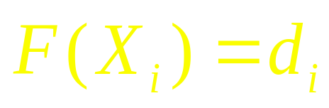
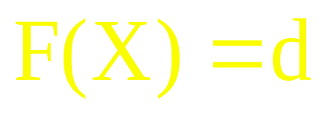
Interpolation Problem(1)
Interpolation problem
  given a set of N different points
  a corresponding set of N real number
  find a function
  that satisfies this condition :
Interpolation function / generalization :

Slide 13
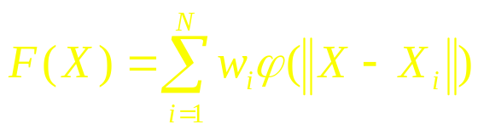
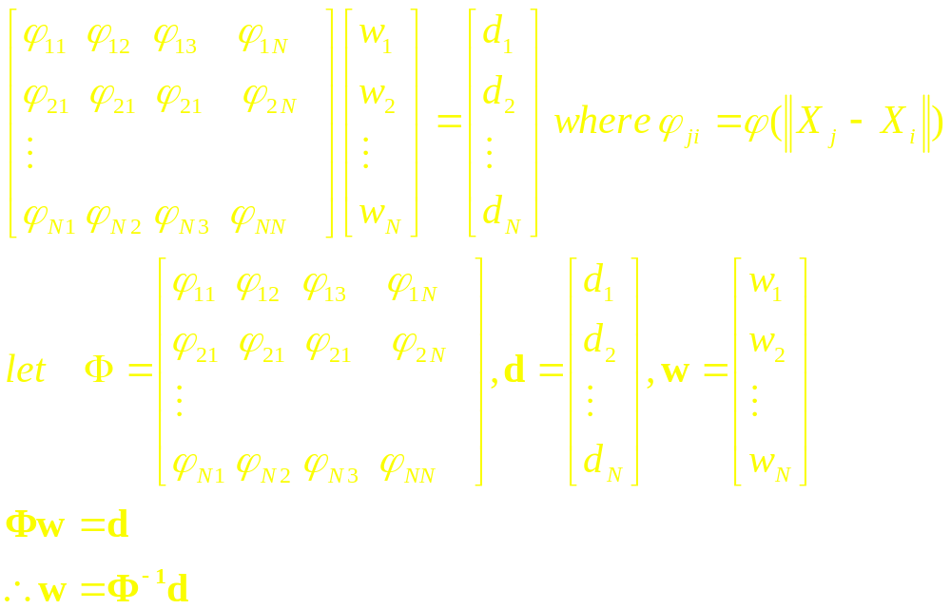
Interpolation Problem(1)
Radial-basis function
  Function Form:
d
x2
x1
Interpolation X from the points Xi (I=1,,,N)
Notes:
We are very used to use three points interpolation etc
each point Xi dominates a spatial distribution
在这里 我们找到的函数是函数的组合（泛函）

Slide 14




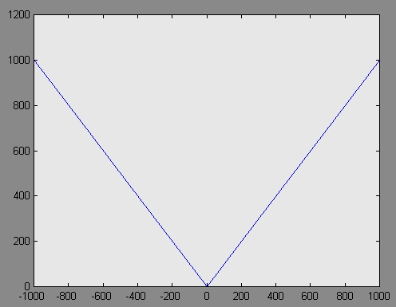
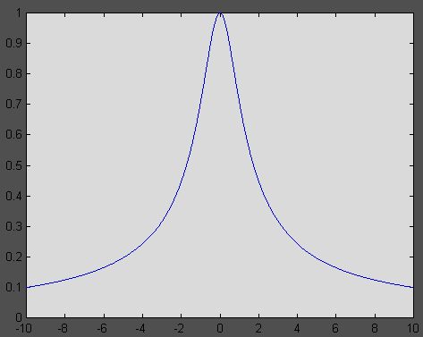
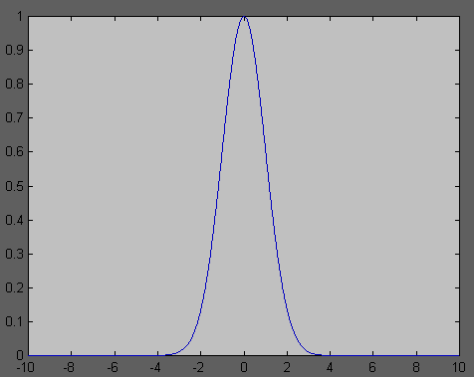
Interpolation Problem(2)
Micchelli’s Theorem
  If be a set of distinct points, then N-by-N interpolation matrix
  is nonsingular
Types of RBF function
  Multiquadrics
  Inverse multiquadrics
  Gaussian functions
Notes:
Radial basis function, here radial -- the r in the three functions, and the meansure |X-Xi|
Radial– 径向的，半径的，射线的，这里的意思是RBF 考虑的只是相对距离 而不管方向如何，只要radial 相同，作用就相同。

Slide 15
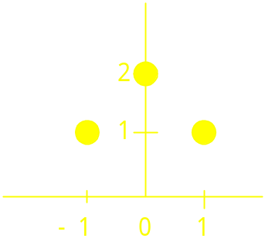
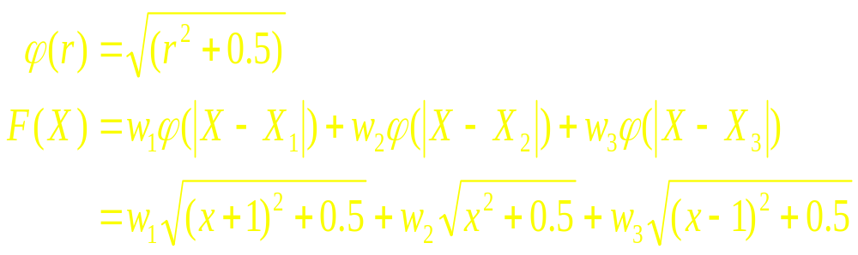
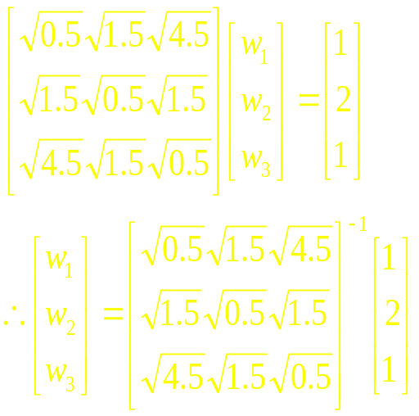
Interpolation Problem(3)
Example (Multiquadrics function)
  {(x,d)} ={ (-1,1),(0,2),(1,1) }
Notes:
这里取 了 m1=3

Slide 16

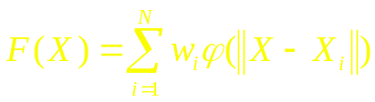

Summary
RBF Networks
  Three layer : Input layer, hidden layer, output layer
  Hidden units provide set of basis functions for input vectors
  Dimension of hidden layer is （much） larger than that of input layer
  Output is obtained from linear combination of hidden functions
Cover’s theorem
  A pattern classification cast in high dimensional space nonlinearly is more likely to be linearly separable than in a low dimension space
Interpolation problem-fitting problem
  Find a function which satisfies
  Use radial basis function : ,
  If be a set of distinct points, then solution exists
  [Micchelli’s Theorem]

Slide 17
Radial-Basis Function Networks
(5.4 ~ 5.5)
091601
  by Huafu Chen
SLST, UESTC, China

Slide 18
ILL Posed Problem (1)
Pitfall of strict interpolation
  Poor Generalization to new data – Overfitting
Forward/Direct VS. Inverse Problem
( Two related problems are said to be the inverse problem of each other if the formulation of each of them requires partial or full knowledge of the other.)

Slide 19
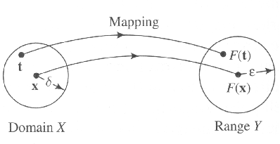
ILL Posed Problem (1)
Well-posed or ill-posed Problem
  problem of reconstruction a mapping / function is “well-posed” if it satisfies ;
    Existence. For every input, there does exist an output.
    Uniqueness ( different input results in different output)
    Continuity-stability
  Otherwise, the problem is “ill-posed”
    meaning : Small information for desired output
    sensitivity, unstability to input noise

Slide 20
ILL Posed Problem (2)
  Learning -- a problem of hyper-surface reconstruction
  (given a set of data points that may be sparse/limited).
Hypersurface Reconstruction is Ill-posed Inverse Problem
  Exist : no distinct output for every input
  Uniqueness : there may not be as much information in the training data as we really need to reconstruct the I/O mapping uniquely
  一致性:在训练数据中可能没有那么多的信息，因为我们确实需要重新构造I/O映射
  Continuity: Noise and imprecision adds uncertainty for I/O mapping
    may generate output over specific range : Violating Continuity
连续性:噪声和不精确增加了I/O映射的不确定性。可能产生超出特定范围的输出:违反连续性?
  To overcome above problem, “Prior Information” must be needed!
    Information about “I/O mappting”

Slide 21
Regularization (1)/page 267
Basic Idea
  stabilize the solution by means of some auxiliary nonnegative functional that embeds prior information about the solution
  通过一些辅助的非负功能来稳定解决方案，从而嵌入解决方案的先验信息。
  prior information involves assumption such as “I/O mapping function Is smooth” / continuity
    In that sense, similar inputs correspond to similar outputs
先验信息包括假设，例如“I/O映射函数是平滑的”/连续性。在这个意义上，类似的输入对应于类似的输出。
Notes:
auxiliary nonnegative functional 含有解的先验信息的非负的辅助泛函

Slide 22



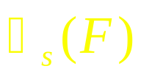
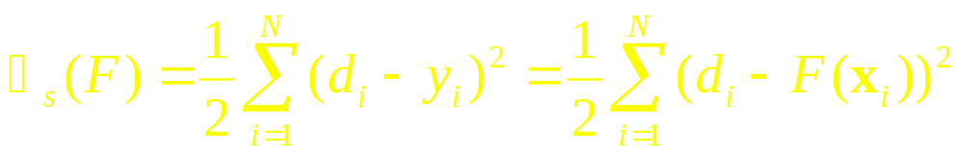
Regularization (1)/page 267
Basic extention
  Let : Input signal : Desired signal :
  assumptions
    output : one-dimensional
    approximating function be denoted by
  Define
    Standard Error Term : Denote
    - error of sample data

Slide 23

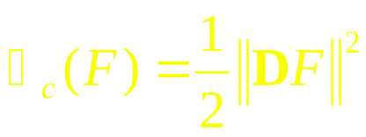
Regularization (2)
  Regularization Term : Denote
    D is a linear differential operator (including prior information about solution - I/O mapping)
    also referred as a stabilizer
Linear differential operator– the function is smooth

Slide 24
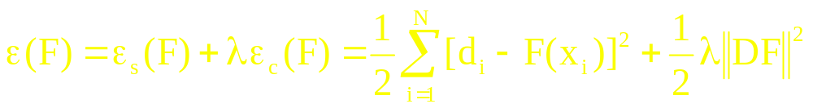





Regularization (2)
  Tikhonov functional : “minimized value”
    : The minimizer of
    lamda : positive real number (regularization parameter)
      indicator of sufficiency of given data set that specify the sol.
      At case , problem is unconstrained ( is completely determined from the examples)
      At case , prior smoothness constraint imposed by D is by itself sufficient to specify the sol. (example is unreliable)

Slide 25


Regularization (3)
    In real world problem, so both sample data and prior information contribute to the solution.
    Thus, represents a model complexity-penaly function
    and the final sol. is influenced by parameter lamda

Slide 26
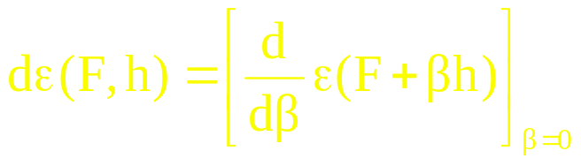
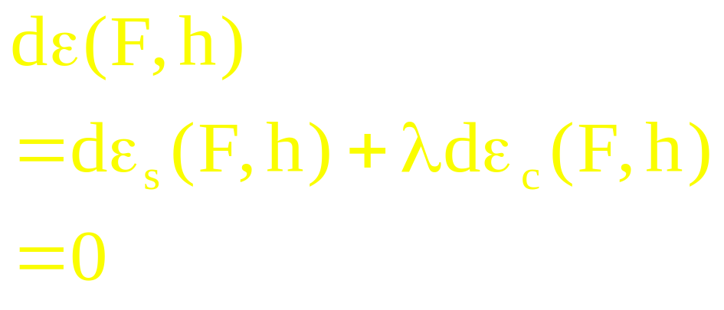
Frechet Differential of the Tikhonov Functional
Frechet Differential for Tikhonov functional
  defined as:
        Here h is an arbitrary but fixed function of x.
  To solve minimizing problem, the condition we needs is:
(5.25)
For every h(x).
Notes:
我们需要 求 E(F) 微分的规则，由于是泛函。
在初等微积分中，曲线上某点的切线 是该点邻域上的曲线的最佳逼近直线，导数 是直线的斜率，斜率为零（切线水平了），即极点。
同理，一个泛函的Frechet微分可以解释为一个最佳局部线性逼近。
E(F)是函数的函数（泛函）， 而这里“最佳”的F(x)应该是这个泛函E(F) 在一定意义下的“极值”，所以要求导， 这里用了 Frechet 导数。
A necessary condition for the function F(x)to be a relative extremum of the functional E(F) is that the Frechet differential dE(F,h) must be zero at F(x) for all h belongs to a functional space, as shown by (5.25)

Slide 27
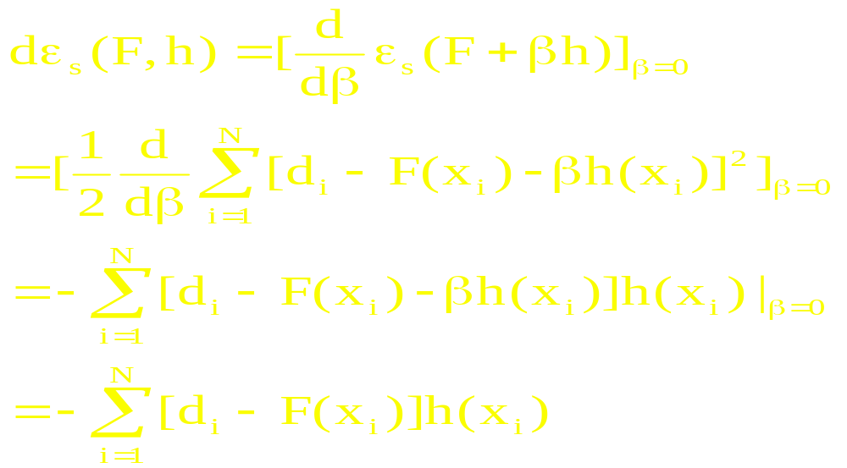
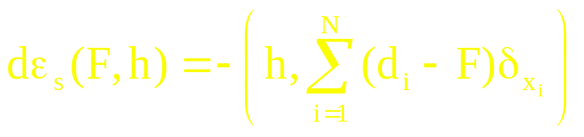
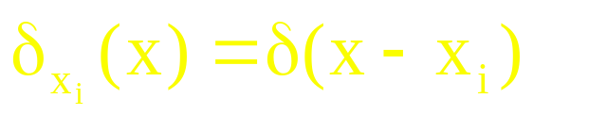
Frechet Differential
of the Tikhonov Functional
(5.26)
Rewrite it
(5.27)
where

Slide 28
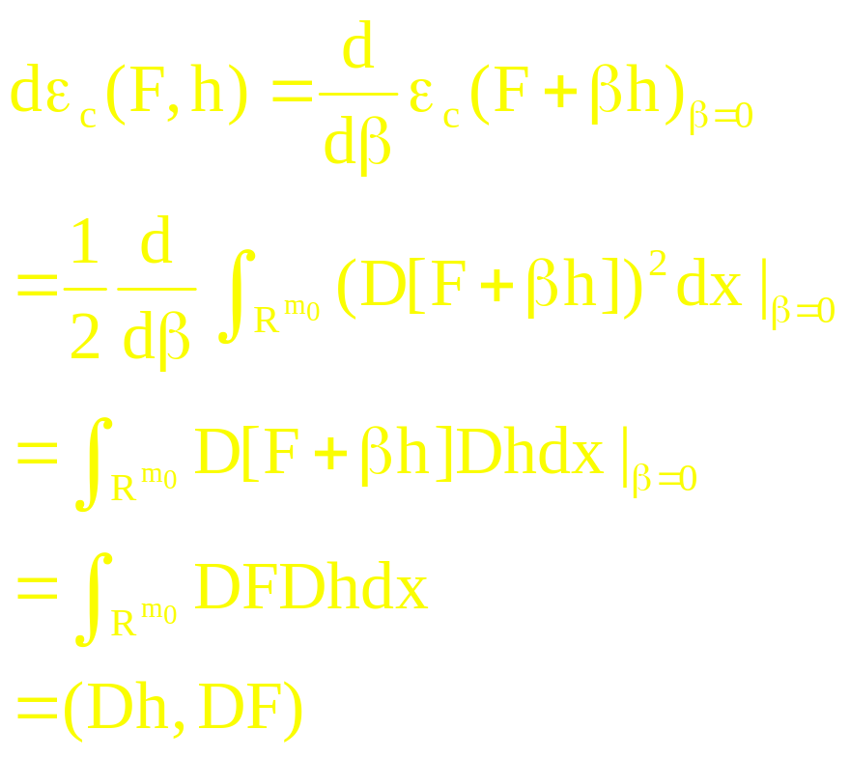

Frechet Differential
of the Tikhonov Functional
(5.29)
      is inner product in Hilbert Space
      (Complete Inner Product Space)
Notes:
（5.29) 与 (5.27) 在形式上还有点不一样 ， 一个(h,…), (Dh,…) 为了化成一样的， 需要后面的adjoint operator 等

Slide 29
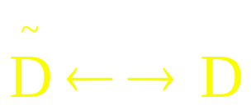
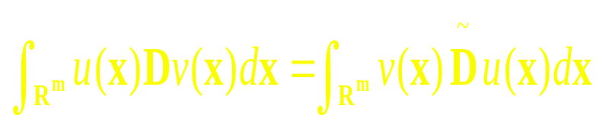
Frechet Differential
of the Tikhonov Functional
adjoint operator
For any pair of functions u(x) and v(x) which are differentiable and satisfy proper boundary conditions
A linear differential operator D and its adjoint operator D’ make
(Green’s identity)
(5.30)
Notes:
adjoint operator 伴随算子

Slide 30
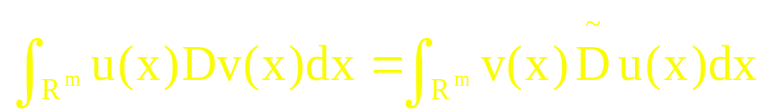
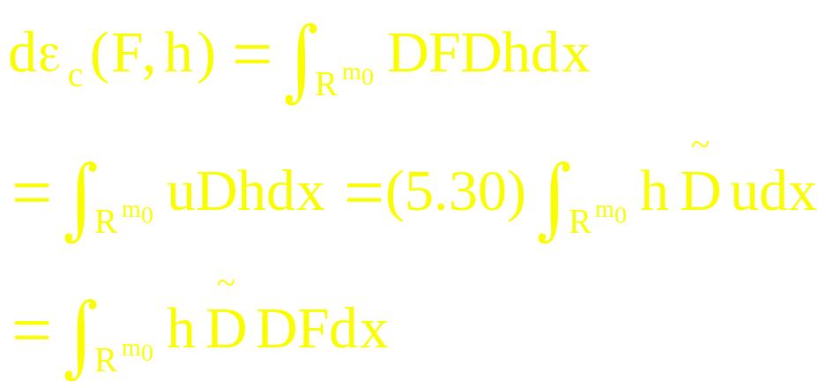
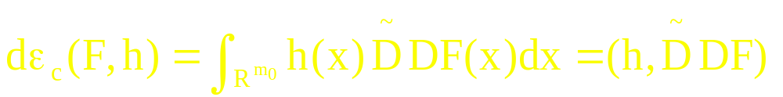
Frechet Differential of the Tikhonov Functional
（5.30）
  Applying this to the equation (5.29)，
    let u(x) = DF(x) and Dv(x) = Dh(x), then
(5.31)

Slide 31
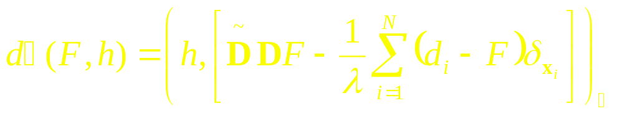

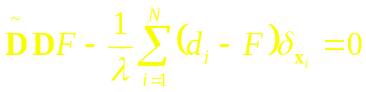
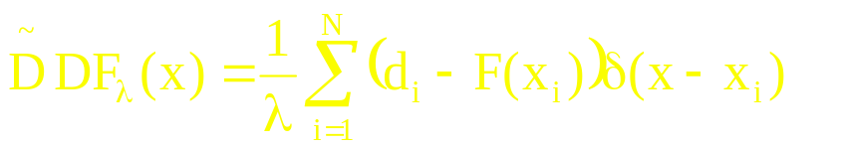

Euler-Lagrange Equation
  Rewrite Equ. (5.25) with Equ. (5.27) and (5.31) :
is zero for every h(x) if
  equivalently
  Equ. (5.33) is Euler-Lagrange equation; necessary condition for Tikhonov functional to have an extremum at
(5.31)
(5.33)
Notes:
为了求解 微分方程 (5.33)– for Flamda，我们引用Green 函数法（见后面）
H 表示 一个完备的内积空间– Hilbert space

Slide 32





Green Function
Definition of Green function/satisfies the three:
1. For a fixed y, G(x,y) is a function of x and satisfies the prescribed boundary conditions.
Except x=y, the derivatives (order is determined by operator L) of G with respect to x are all continuous.
3. LG(x,y)=0, except x=y; or say
LG(x,y)=delta(x-y)
For Green Function , a given differential operator L, and a continuous function
equ.
is a sol. of diff. equ.
(5.36)
(5.37)

Slide 33
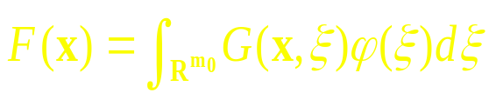

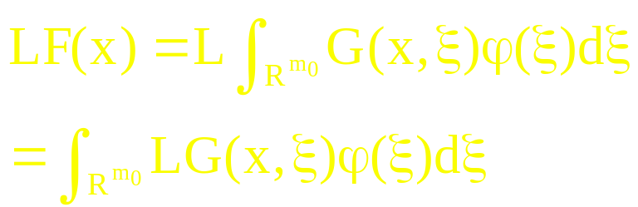
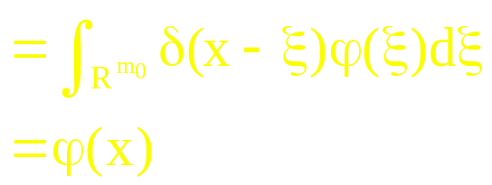

Green Function
Proof of eq.(5.36) is a solution of (5.37)
Vs.

Slide 34

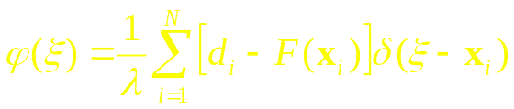
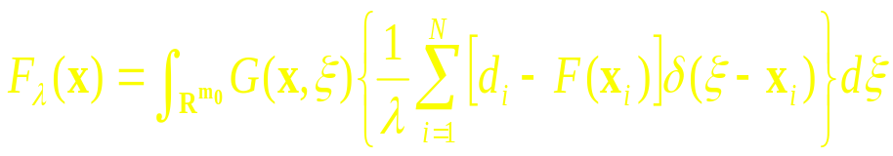
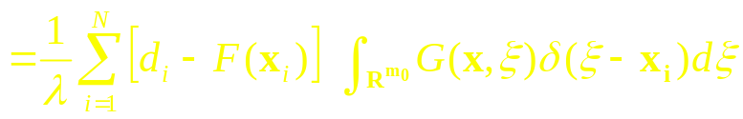
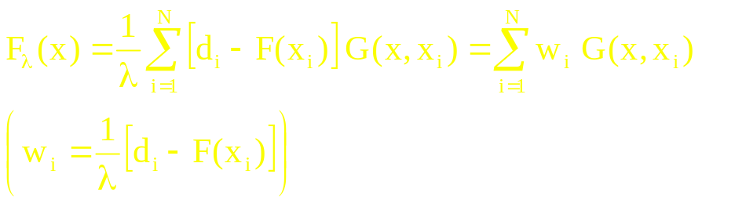
Sol. to the Regularization Problem
Return to the Euler-Lagrange equation
which is derived in our Regularization problem
We have and then sol. described above will be changed :
Using sifting property of Dirac delta ftn., finally we get :
  xi is center of expansion and weights represent the coefficients
  The final sol. is linear weighted sum of basis for this subspace. - G(x,xi) -- quite similar to the RBF interpolation !!!
(5.41)
Notes:
DF(x), the original function F(x)
F(lamda)(x) is the regularization solution for the Tikhonov regularization
(di-F(xi) 越大的地方，原始函数拟合越差，权越大，

Slide 35









Determination of coefficient
Let , , and
then Equ. (5.41) will be such :
and
, so
  ( See page 274)

Slide 36





Conclusion
The solution of regularization is
  This equ. states following:
    The regularization approach is equivalent to the expansion of the sol. in terms of a set of Green’s function, specified by D and associated boundary conditions.
    # of Green’s function = # of examples used in the training process
If D is translationally and rotationally invariant, G(x, xi) will depend on the Euclidean norm of the difference vector :
  Under these conditions, Green’s ftn. must be a radial-basis ftn, then solution takes special form , which construct a linear function space with Euclidean distance measure.
(5.57)
This solution/(5.54) is different from (5.11)/(5.16) with a regularization

Slide 37


An example of the Green Function
Multivariate Gaussian Functions
defined
  xi : center of the ftn, : width of ftn.
(5.59)
The operator L -- (5.60)
Operator D and its adjoint operator– (5.63)/(5.64)
The differential equation of the Green function is (5.65)
The solution is (5.66)
Notes:
按照前面的推理，我们是先假设 微分算子D，然后 利用它对应的 Green 函数 来生成我们的 RBF，这里说的是，如果我们假设RBF函数就是 Gauss 函数，我们可以找到它的 微分算子情况，因此也就是说，我们采用 Gauss 函数是 符合前面讲的理论的。
书中说，由于这里L=D~D的项数容许到无穷，因此 不是严格意义上的 微分算子，但可以称为伪 pseudo-differential operator

Slide 38


  It is a radial basis function( a case of equ (5.57))
  The regularized solution takes the form of a linear superposition as follows:
(5.66)
  Each Gaussian /function member is assigned different variances. To simplify matters, same variance is often imposed on F(x).
  Even though some limitation exist for this case, RBF networks are still universal approximators.

Slide 39
The self-adjoint operator L is found to be (5.60)
And the Green’s function equation is (5.65)
  Each Gaussian member are assigned different variances. To simplify matters, same variance is often imposed on F(x).
  Even though some limitation exist, RBF networks are still universal approximators

